Slide 1
SANSKRITI
P Roshini 1602-20-737-032
P Sneha Anjali 1602-20-737-302
G Deeksha 1602-20-737-010

Slide 2
Motivation
The motivation behind building this website is to showcase the rich heritage and culture of South India.
We want to show the rich culture and heritage under one platform.

Slide 3
Abstract Do you know different cultural sites ,UNESCO sites, heritage sites and dance forms of South India? Our Idea is to show case the cultural sites , UNESCO sites , heritage sites and dance form on a web application. It will show case and plot the cultural sites , UNESCO sites , heritage sites and dance forms according to the states. The goal of our project is to show culture and heritage sites of south India and also it will be user friendly application.

Slide 4
Introduction to Problem statement
Our problem statement is to show case rich culture and heritage of south India
Culture is the way of life how the people live it includes various festivals and dance forms celebrated all over the south India. India has diverse people in it speaking different languages in different locations.
In heritage we get to see various astonishing structures built in past era and also some of the sites were awarded with UNESCO heritage sites.
Human beings live with different flora and fauna on this incredible earth. We tend to show case the national parks in south India.

Slide 5
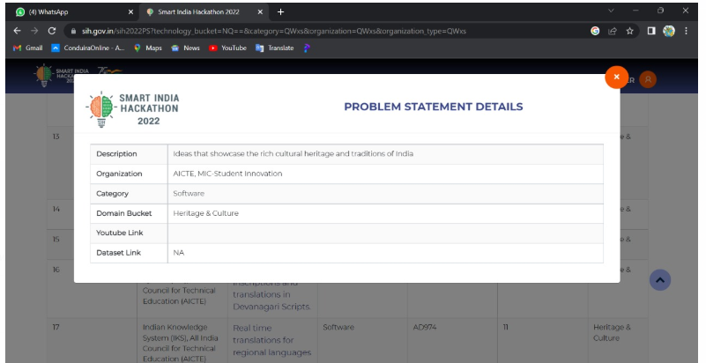

Slide 6
Description about Project
In first step we collect data regarding different cultural and heritage sites of India
The user need to login to use the web application and search data.

Slide 7
Description about Project
The user searches on the web application regarding different cultural and heritage sites
The application will show the information and it will direct to the page
The application will show the culture and heritage sites according to the states.

Slide 8
DESIGN OF THE PROJECT
The website was developed using html , css and javascript
Backend was designed using php

Slide 9
TECHNOLOGY USED
Hardware Requirements:
Laptop, Internet connection
Software Requirements
vs code , xampp
Languages used: python , html , css , javascript , php

Slide 10
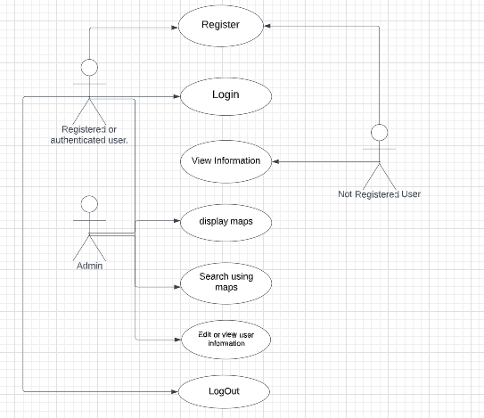

Slide 11
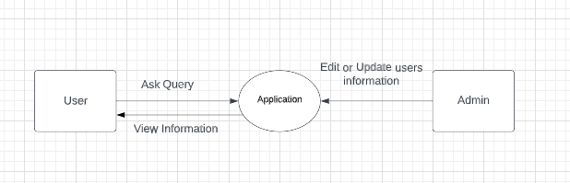
DATAFLOW DIAGRAM
,

Slide 12
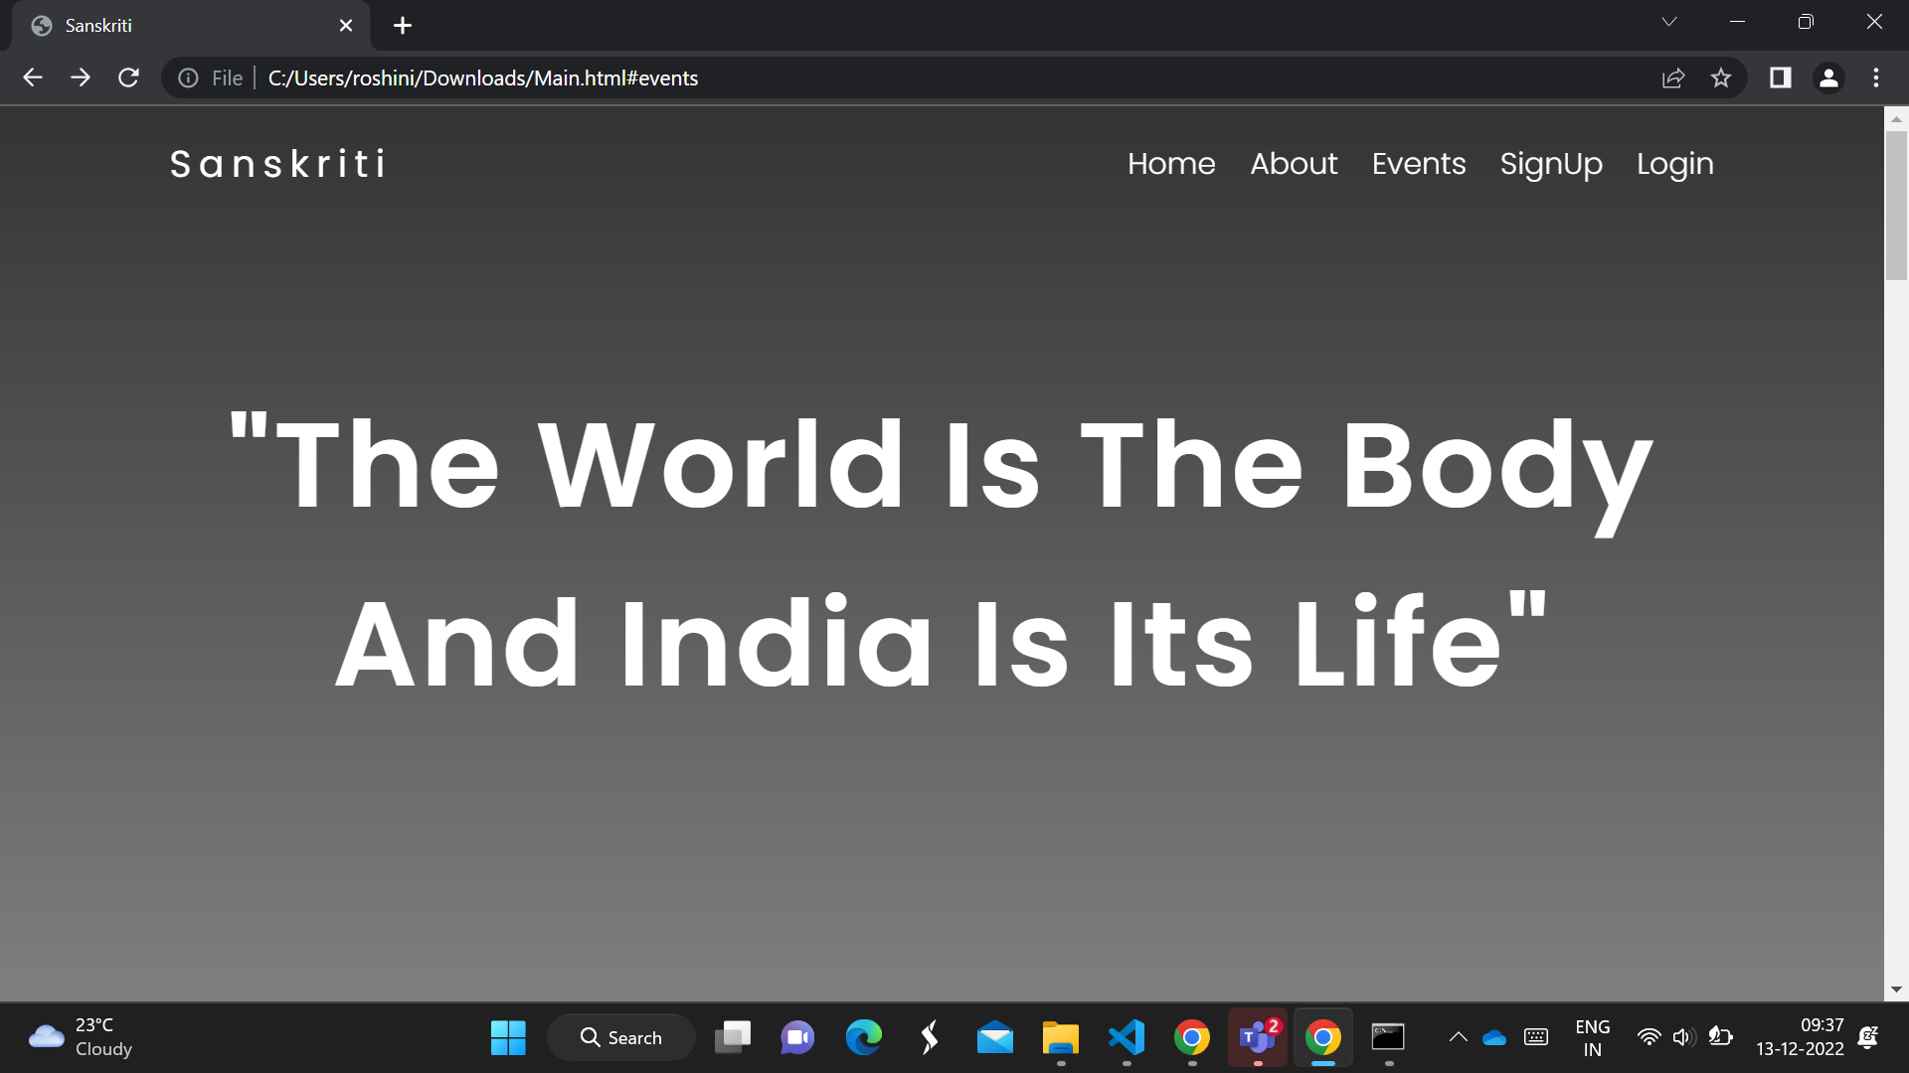

Slide 13
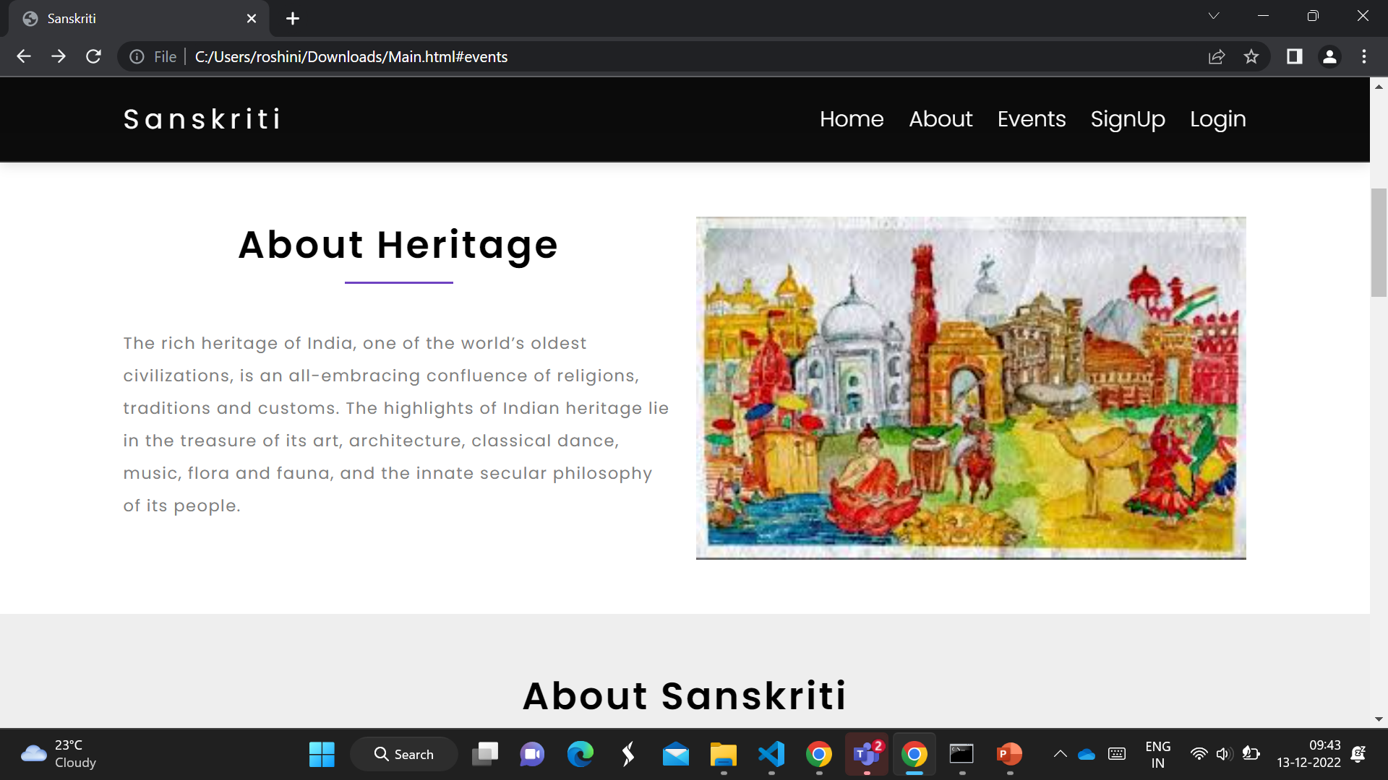

Slide 14
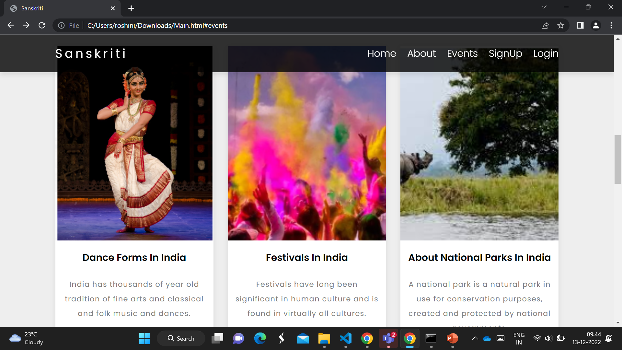

Slide 15
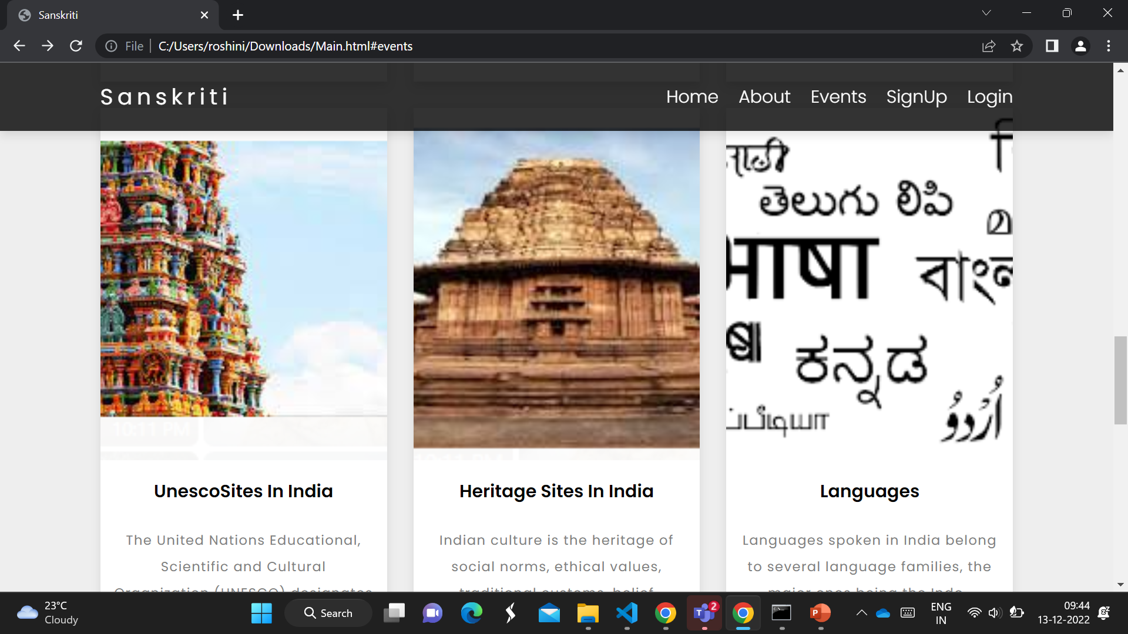

Slide 16
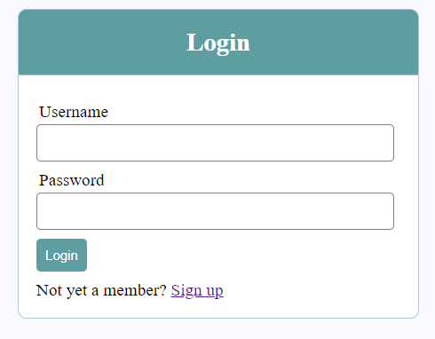

Slide 17
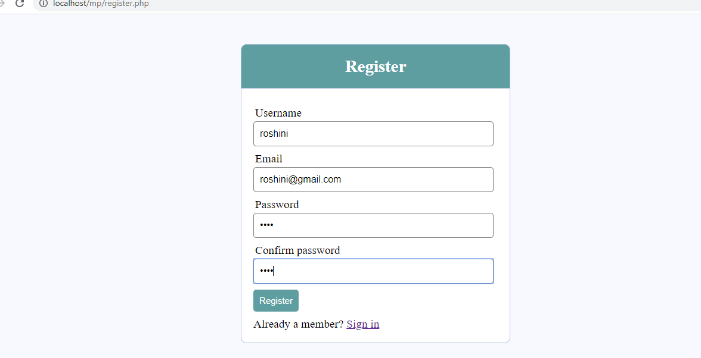

Slide 18
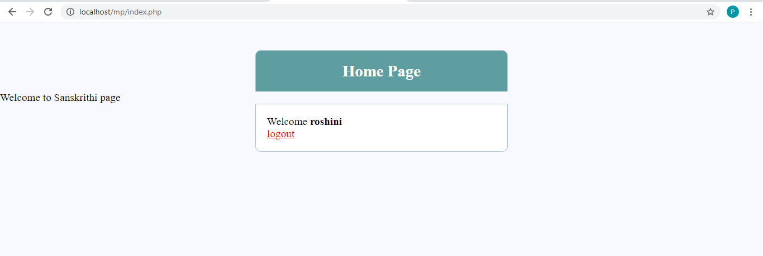
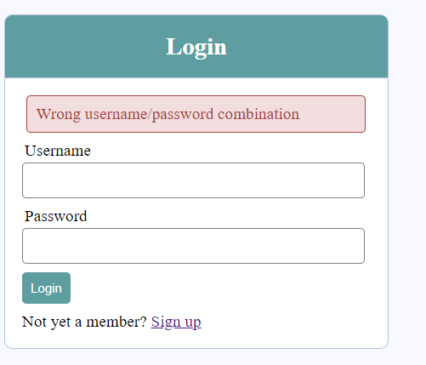
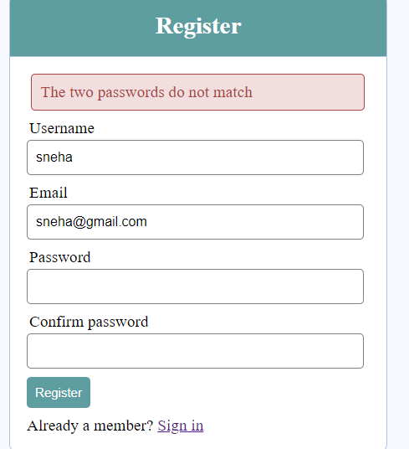
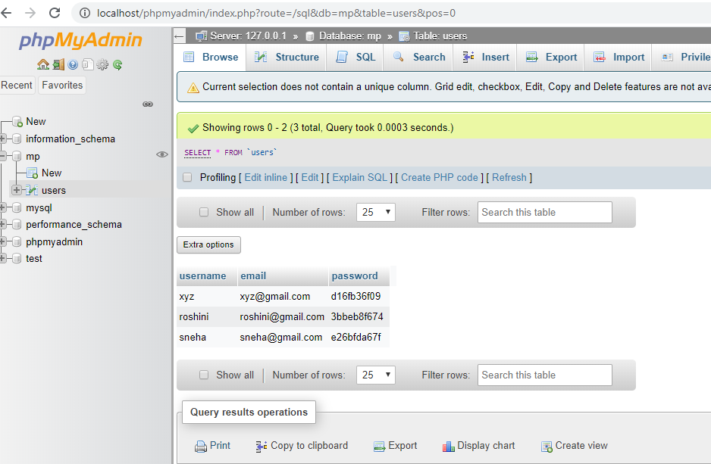

Slide 19
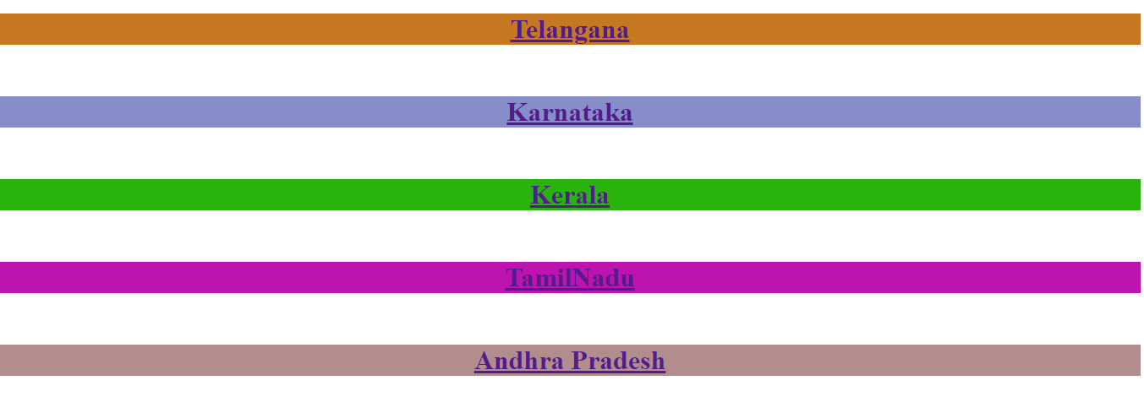

Slide 20
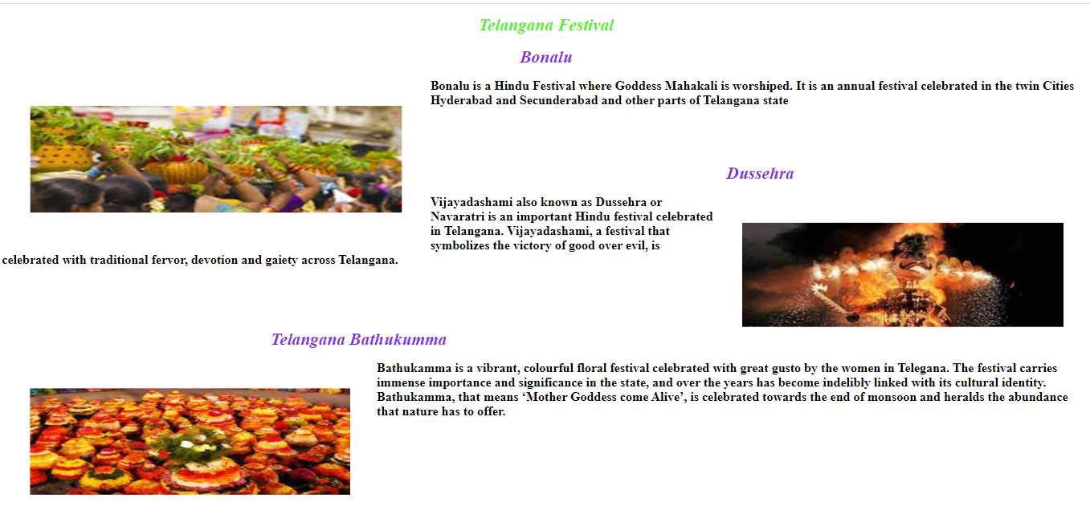

Slide 21
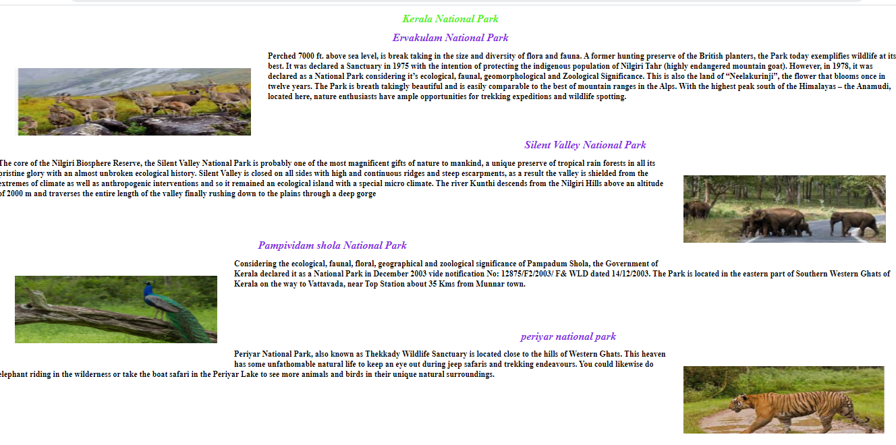

Slide 22
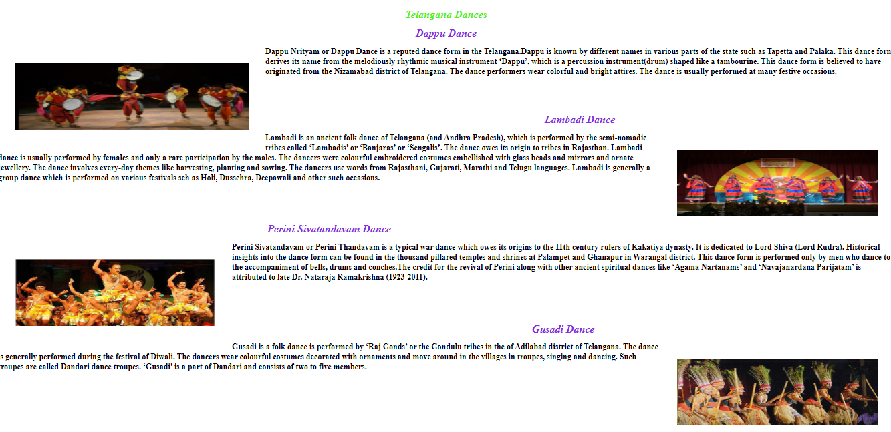

Slide 23
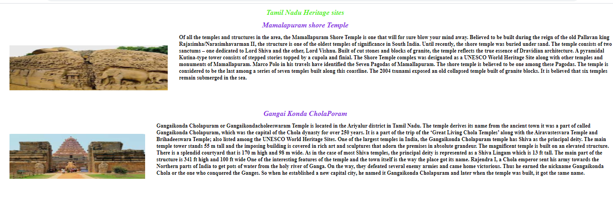

Slide 24
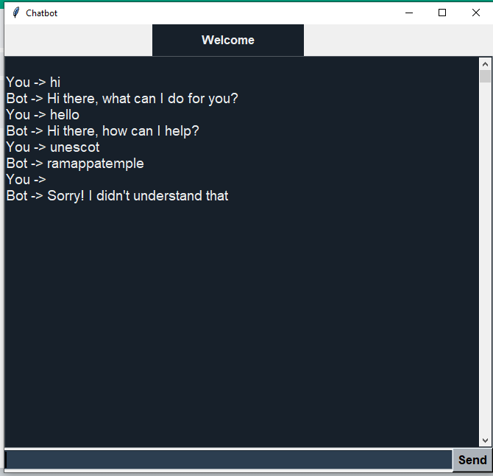

Slide 25
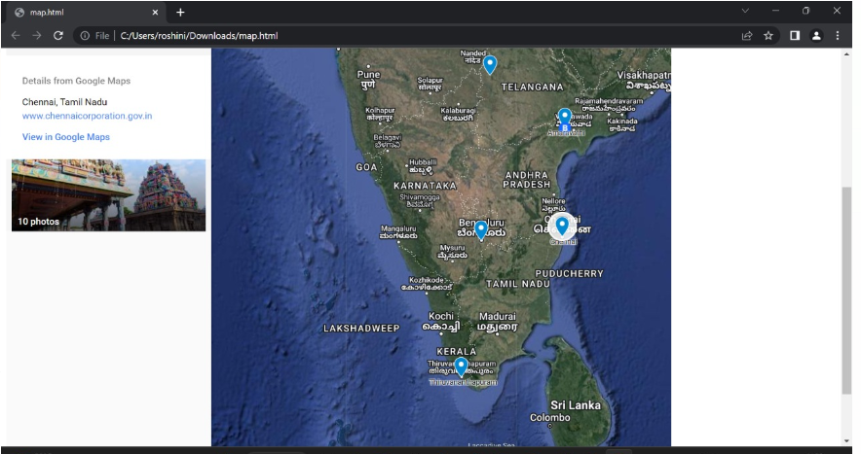

Slide 26
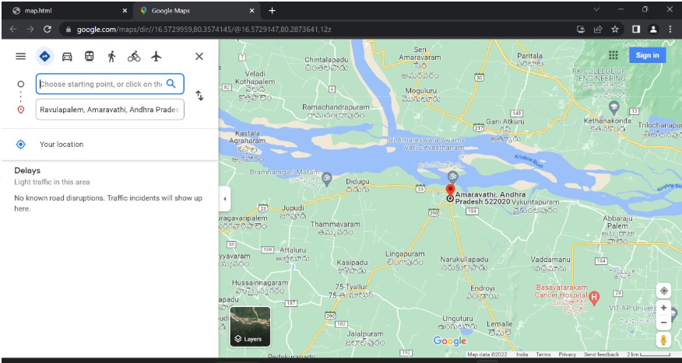

Slide 27
FUTURE SCOPE
We can add search engines to make websites user friendly
we can add speech to text translation to get information quickly
Providing recommendations to users about heritage sites of South India.

Slide 28
CONCLUSION
These kind of websites can be used as references to get information about culture and heritage sites of India
These websites can also act as rich information spaces to explore about culture and heritage in India
To locate places google maps are used to get birds eye view of the location

